Slide 1
Lecture 9
Topics: Thinking in Objects, Part II
Chapter 10, Section 10.10

Slide 2
The String Class
The String data type comes from the String class.
The String class has 13 constructors and more than 40 methods for manipulating strings.
A String object is immutable: Its content cannot be changed once the string is created.
String s = "Java";
s = "HTML";
main (Stack)
Heap
s
Java
HTML

Slide 3

Ways to create String objects
String literal: A series of characters in your code that is enclosed in double quotes. Whenever it encounters a string literal in your code, the compiler creates a String object with the value enclosed in quotes.
String s = "Hello world!";
Using the new keyword with a String constructor.
String s = new String("Hello world!");
char[] a = {'h', 'e', 'l', 'l', 'o' }; String s = new String(a);
⇒ A String object with the value "hello"

Slide 4
Interned Strings
To save memory (and speed up testing for equality), Java supports "interning" of Strings.
When the intern() method is invoked on a String, a lookup is performed on a table of interned Strings.
If a String object with the same content is already in the table, a reference to the String in the table is returned.
Otherwise, the String is added to the table and a reference to it is returned.
The result is that after interning, all Strings with the same content will point to the same object.

Slide 5
Interned Strings (cont.)
Interning saves space, and also allows Strings to be compared using the == operator, which is much faster than comparison with the equals() method.
Java automatically interns String literals (NOT Strings created using the new operator with a constructor).
In many cases, the == operator appears to work for Strings in the same way that it does for ints or other primitive values.
Code written based on this assumption will fail in a potentially non-obvious way when the == operator is used to compare Strings with equal content - it only works for values available at compile-time.

Slide 6
Interned Strings and Equality
String s1 = "string7";
String s2 = new String("string7");
String s3 = "string" + 7;
String s4 = "string" + s1.length();
System.out.println(s1 == s2);
System.out.println(s1 == s3);
System.out.println(s1 == s4);
System.out.println(s1.equals(s2));
System.out.println(s1.equals(s4));
false
true
false
true
true

Slide 7
Converting a String to a character array
Strings are not arrays.
A String can be converted into an array of characters.
To convert a String into an array of characters use the toCharArray() method.
String c = "Java";
char[] cArray = c.toCharArray();
for (int i = 0; i < cArray.length; i++)
System.out.println(cArray[i]);
Output
J
a
v
a

Slide 8
Converting characters and numeric values to Strings
You can convert a character or a number into a String by using the concatenating operator (+) and concatenating it with an empty String ("").
You can also use the static overloaded method valueOf() from the String class.

Slide 9
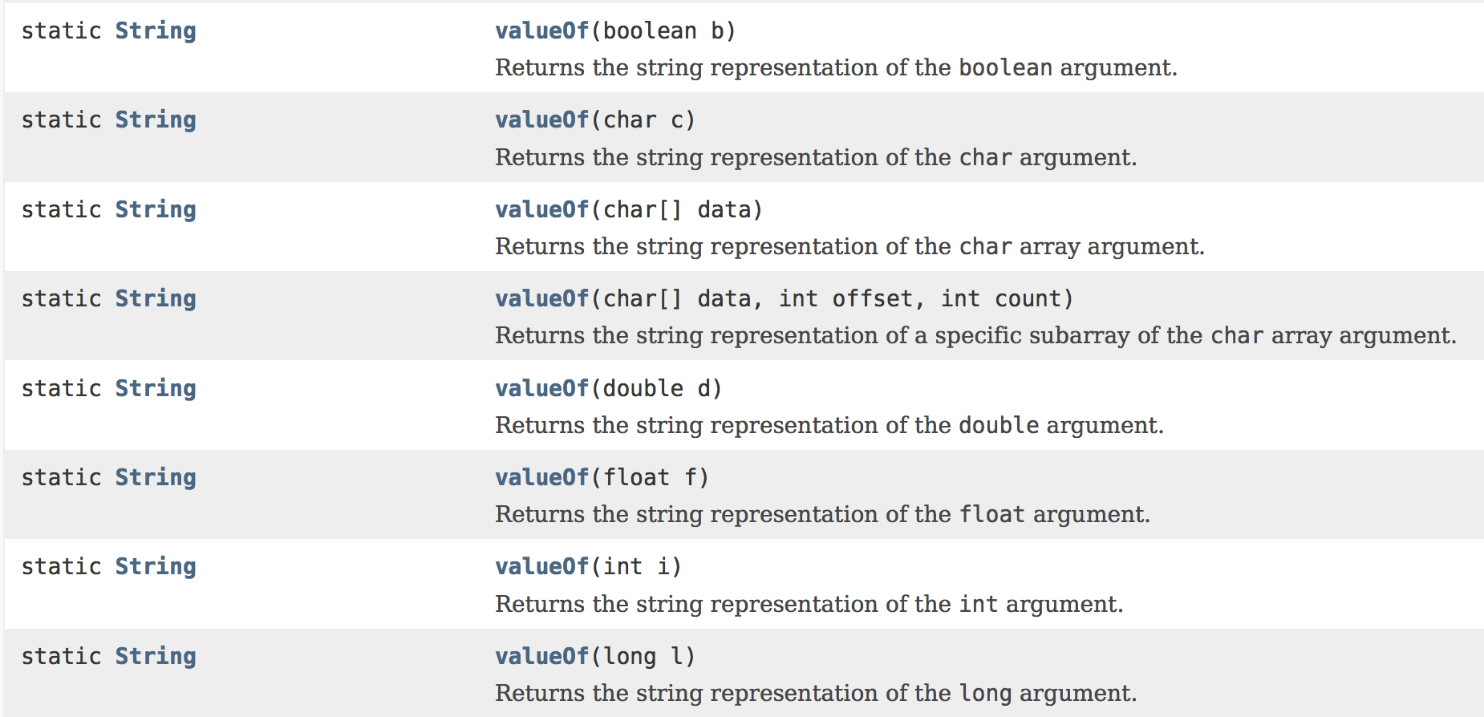

Slide 10
Examples
String s1 = String.valueOf(5.44);
String s2 = String.valueOf('q');
String s3 = String.valueOf(true);
main (Stack)
Heap
5.44
s1
q
s2
true
s3

Slide 11
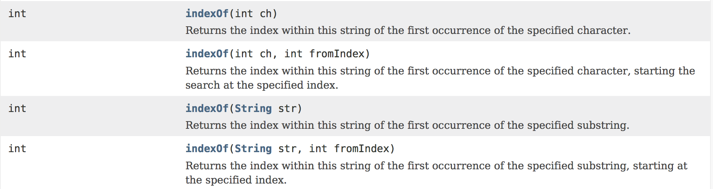
The indexOf String method
The indexOf method returns the first index at which the specified character or String appears.
There are 4 overloads!

Slide 12
Examples
String s = "BABAYRTAJGHSAB";
int i1 = s.indexOf('A');
int i2 = s.indexOf('A', 4);
int i3 = s.indexOf("AB");
int i4 = s.indexOf("AB", 5);
System.out.println(i1);
System.out.println(i2);
System.out.println(i3);
System.out.println(i4);
Output
1
7
1
12

Slide 13
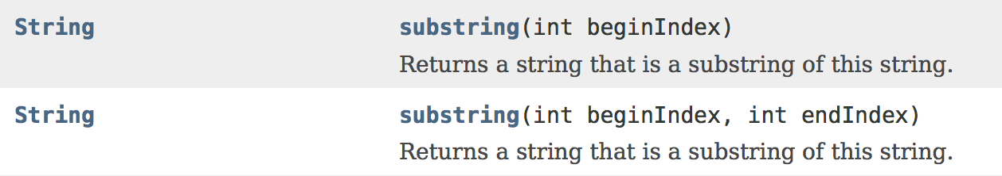
The substring String method
The one-parameter substring method returns the portion of the String beginning at the index specified by the parameter all the way to the end of the String.
The two-parameter substring method returns the portion of the String beginning at the index specified by the first parameter all the way up to, but not including, the second parameter.

Slide 14
Examples
String s = "Creativity takes Courage";
String s1 = s.substring(0, 10);
String s2 = s.substring(17);
String s3 = s.substring(17, 23);
System.out.println(s1);
System.out.println(s2);
System.out.println(s3);
Output
Creativity
Courage
Courag

Slide 15
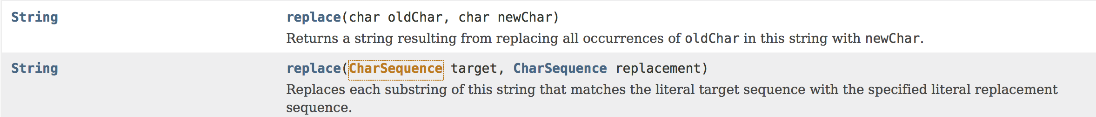
Replacement within Strings
Once a string is created, its contents cannot be changed (immutable).
The replace method(s) return a new String derived from the original string with a specified character or substring replaced by another character or substring.
Each occurrence of the specified character or substring is replaced.
This is just a String replaced by another String.

Slide 16
String s1 = "Welcome";
String s2 = s1.replace('e', 'A');
String s3 = s1.replace("el", "AB");
s3 = s2.replace("W", "LE");
main (Stack)
Heap
Welcome
s1
String s1 = "Welcome";
String s2 = s1.replace('e', "AB");
WAlcomA
s2
You can only replace:
A character with another character
A String with another String.
WABcome
s3
LEAlcomA

Slide 17
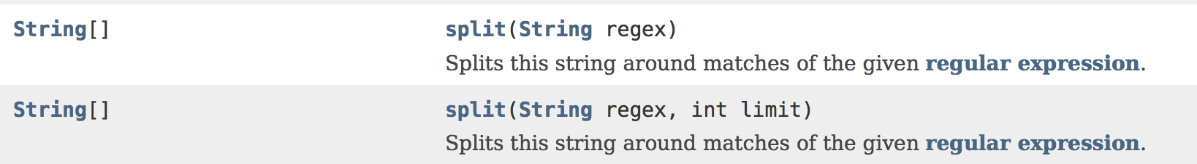
Splitting Strings
Once a string is created, its contents cannot be changed (immutable).
The split method(s) return a new String array where each element of the array is a section of where the String was "cut". Note: The original String itself is not modified.
The method parameter indicates how you want to split the String and any instances of that parameter are "removed" - i.e. not included in the String array that is returned.

Slide 18
String s = "Java#HTML#Perl";
String[] splitS = s.split("#");
for (int i = 0; i < splitS.length; i++)
{
System.out.println(splitS[i]);
}
main (Stack)
Heap
Java#HTML#Perl
s
{ , , }
splitS
i: 0
Output
1
2
Java
HTML
Perl
Java
HTML
Perl
3

Slide 19
Regular Expressions
Often you will need to write code that validates user input.
Regular expression (regex): A String that describes a pattern for matching a set of Strings.
Regular expressions are created inside double quotes ("") similar to other Strings.
Regular expressions can be very complex.
Additional information: https://developer.mozilla.org/en-US/docs/Web/JavaScript/Guide/Regular_Expressions

Slide 20
Regular Expressions: Basic Syntax
. (dot) : Matches any single character, except a new line.
* : Matches 0 or more occurrences of the preceding item.
\ : A backslash that precedes a non-special character indicates that the next character is special and is not to be interpreted literally. A backslash that precedes a special character indicates that the next character is not special and should be interpreted literally.
{n} : Match the preceding expression exactly n times.
\d : Matches any digit from 0-9. Note the backslash!
[ ] : Character set. This pattern type matches any one of the characters in the brackets.

Slide 21
Regular Expressions: Examples
"Java.*"
Look for the word Java followed by any number of other characters.
"\\d{3}-\\d{2}-\\d{4}"
Look for three numbers, then a dash, then 2 numbers, then a dash, then 4 numbers.
"[a-z][A-Z0-9]*"
Any lowercase character followed by any number of characters from the uppercase set A-Z and 0-9.

Slide 22
Why is regex useful?
Strings have a method named replaceAll that takes a String or a String regular expression.
This method returns a new String that finds substrings based on a regular expression and replaces them with a different pattern.
String s = "a+b$#c";
String s2 = s.replaceAll("[$+#]", "NNN");
System.out.println(s2);
Output: aNNNbNNNNNNc

Slide 23
Why is regex useful? (cont.)
Strings have another split method that takes a String or a String regular expression.
This method returns a new String array by splitting the original String based on a regular expression.
String s = "Java,C?C#,C++";
String[] splitS = s.split("[.,:;?]");
for (int i = 0; i < splitS.length; i++)
System.out.println(splitS[i]);
Output:
Java
C
C#
C++

Slide 24
Why is regex useful? (cont.)
matches method: Similar to the equals method in that it evaluates to a boolean value, but is much more powerful because it can match fixed Strings and regular expressions.
String s1 = "Java";
String s2 = "Java is fun";
String s3 = "440-02-4534";
S.O.P.L(s1.matches("Java.*"));
S.O.P.L(s2.matches("Java.*"));
S.O.P.L(s1.matches(".*Java"));
S.O.P.L(s2.matches(".*Java"));
S.O.P.L(s3.matches("\\d{3}-\\d{2}-\\d{4}"));
S.O.P.L(s3.matches("\\d{2}-\\d{2}-\\d{4}"));
Output:
true
true
true
false
true
false

Slide 25


Which String methods do I have to know for Exam #2 and the Final Exam?
All of the methods described in this lecture!

Slide 26
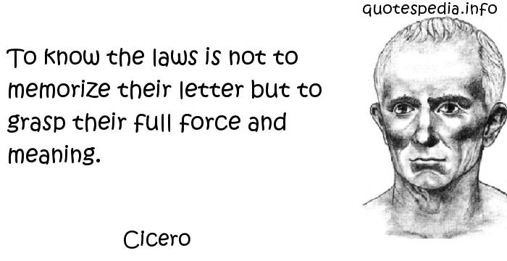
That’s all for today!
Homework #6 is due Thursday, 03/03/16
References: http://javatechniques.com/blog/string-equality-and-interning/

